Slide 1


Slide 2
Supplement A
Linear Programming Using Excel Solver

Slide 3
OBJECTIVES
Linear Programming Basics
A Maximization Problem
A Minimization Problem
Notes:
2

Slide 4
Linear Programming Essential Conditions
Is used in problems where we have limited resources or constrained resources
The model must have an explicit objective (function)
  Generally maximizing profit or minimizing costs subject to resource-based, or other, constraints
Notes:
3

Slide 5
Linear Programming Essential Conditions (Continued)
Linearity is a requirement of the model in both objective function and constraints
Homogeneity of products produced (i.e., products must the identical) and all hours of labor used are assumed equally productive
Divisibility assumes products and resources divisible (i.e., permit fractional values if need be)
Notes:
3

Slide 6
Objective Function
Maximize (or Minimize) Z = C₁X₁ + C₂X₂ + ... + C_{n}X_{n}
C_{j} is a constant that describes the rate of contribution to costs or profit of (X_{j}) units being produced
Z is the total cost or profit from the given number of units being produced
Notes:
5

Slide 7
Constraints
A₁₁X₁ + A₁₂X₂ + ... + A_{1n}X_{n}≤B₁
A₂₁X₁ + A₂₂X₂ + ... + A_{2n}X_{n} ≥B₂
:
:
A_{M1}X₁ + A_{M2}X₂ + ... + A_{Mn}X_{n}=B_{M}
A_{ij} are resource requirements for each of the related (X_{j}) decision variables
B_{i} are the available resource requirements
Note that the direction of the inequalities can be all or a combination of ≤, ≥, or = linear mathematical expressions
Notes:
5

Slide 8
Non-Negativity Requirement
X₁,X₂, …, X_{n} ≥ 0
All linear programming model formulations require their decision variables to be non-negative
While these non-negativity requirements take the form of a constraint, they are considered a mathematical requirement to complete the formulation of an LP model
Notes:
5

Slide 9
An Example of a Maximization Problem
LawnGrow Manufacturing Company must determine the unit mix of its commercial riding mower products to be produced next year. The company produces two product lines, the Max and the Multimax. The average profit is $400 for each Max and $800 for each Multimax. Fabrication hours and assembly hours are limited resources. There is a maximum of 5,000 hours of fabrication capacity available per month (each Max requires 3 hours and each Multimax requires 5 hours). There is a maximum of 3,000 hours of assembly capacity available per month (each Max requires 1 hour and each Multimax requires 4 hours). Question: How many units of each riding mower should be produced each month in order to maximize profit?
Now let’s formula this problem as an LP model…
Notes:
6

Slide 10
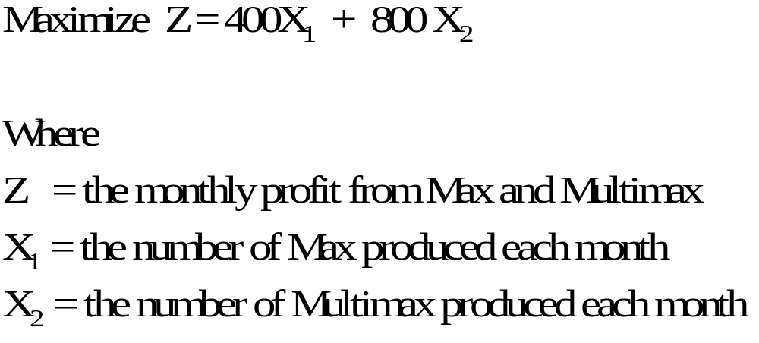
The Objective Function
If we define the Max and Multimax products as the two decision variables X₁ and X₂, and since we want to maximize profit, we can state the objective function as follows:
Notes:
8

Slide 11
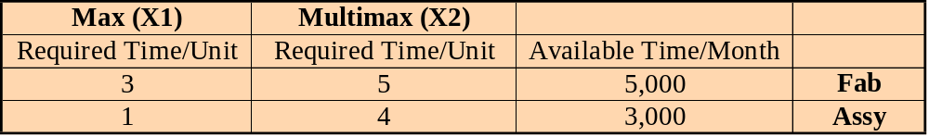
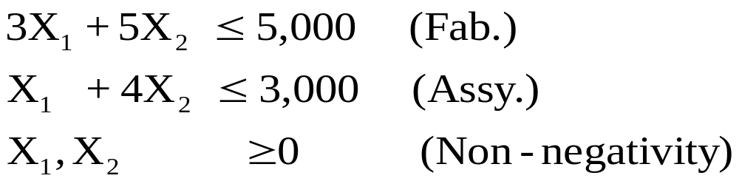
Constraints
Given the resource information below from the problem:
We can now state the constraints and non-negativity requirements as:
Note that the inequalities are less-than-or-equal since the time resources represent the total available resources for production
Notes:
9

Slide 12
Solution
Produce 715 Max and 571 Multimax per month
for a profit of $742,800
Notes:
16

Slide 13
An Example of a Minimization Problem
HiTech Metal Company is developing a plan for buying scrap metal for its operations. HiTech receives scrap metal from two sources, Hasbeen Industries and Gentro Scrap in daily shipments using large trucks. Each truckload of scrap from Hasbeen yields 1.5 tons of zinc and 1 ton of lead at a cost of $15,000. Each truckload of scrap from Gentro yields 1 ton of zinc and 3 tons of lead at a cost of $18,000. HiTech requires at least 6 tons of zinc and at least 10 tons of lead per day. Question: How many truckloads of scrap should be purchased per day from each source in order to minimize scrap metal costs to HiTech?
Now let’s formula this problem as an LP model…
Notes:
17

Slide 14
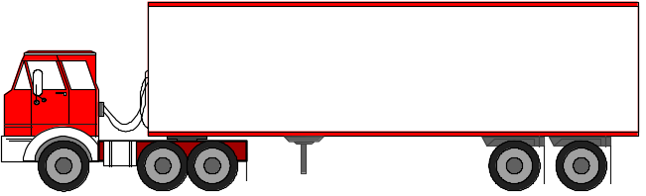
The Objective Function
If we define the Hasbeen truckloads and the Gentro truckloads as the two decision variables X₁ and X₂, and since we want to minimize cost, we can state the objective function as follows:
Minimize Z = 15,000 X₁ + 18,000 X₂
Where
Z = daily scrap cost
X₁ = truckloads from Hasbeen
X₂ = truckloads from Gentro
Hasbeen
Gentro
Notes:
18

Slide 15
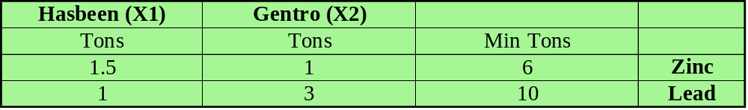
Constraints
Given the demand information below from the problem:
We can now state the constraints and non-negativity requirements as:
Note that the inequalities are greater-than-or-equal since the demand information represents the minimum necessary for production.
1.5X₁ + X₂ > 6(Zinc/tons)
X₁ + 3X₂ > 10(Lead/tons)
X₁, X₂ > 0(Non-negativity)
Notes:
19

Slide 16
Solution
Order 2.29 truckloads from Hasbeen and 2.57
truckloads from Gentro for daily delivery. The daily
cost will be $80,610.
Note: Do you see why in this solution that
“integer” linear programming methodologies
can have useful applications in industry?
Notes:
25

Slide 17
End of Supplement A

